Slide 1

RISC-V FPGA for Computer Vision Applications
Tutorial 3: Modifying the Demo Project
EE 297A/B
Friday, November 6, 2020
Project Members:
Anee Mineshkumar Dubhia^{[1]}
Chee Vang^{[2]}
Advisor:
Professor Harry Li, Ph. D.^{[3]}

Slide 2
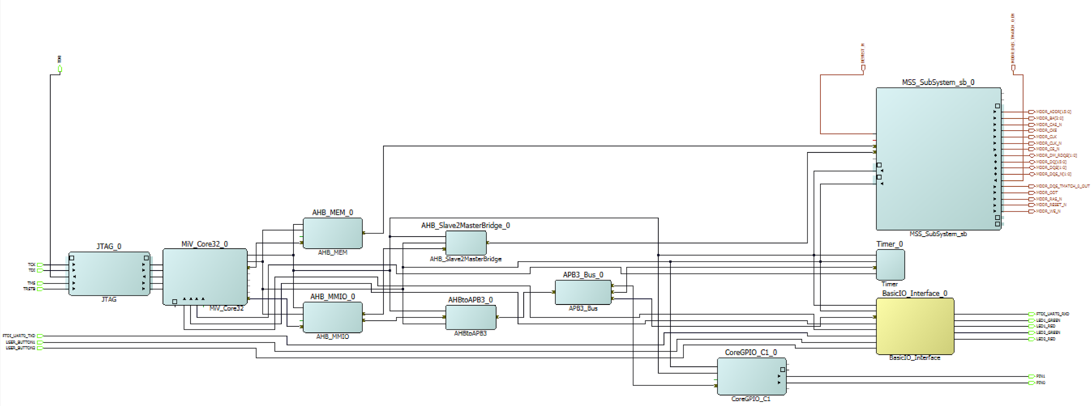

Modified SmartDesign
Fig. 1. SmartDesign layout modified with CoreGPIO and output ports

Slide 3
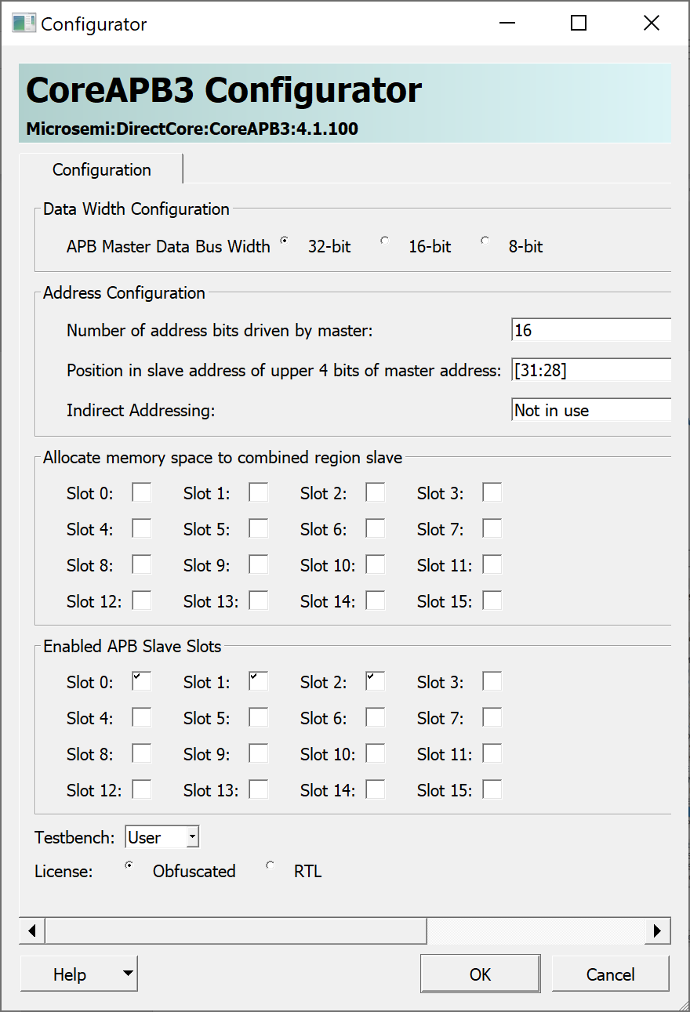
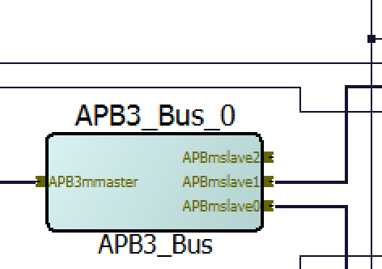
Step 1: Enable additional APB Slaves
Double click on APB3_Bus_0 Module in SmartDesign
Check Slot 2 to increase number of APB slaves
Click OK
Right-click APB3_Bus_0 and choose Update Component
There is now 3 APB slaves.
Fig. 3. Modified APB3_BUS_0
Why? Because some IP cores are interfaced through APB in Libero SoC IDE
Fig. 2. APB3_BUS_0 configuration to enable a new slave device

Slide 4
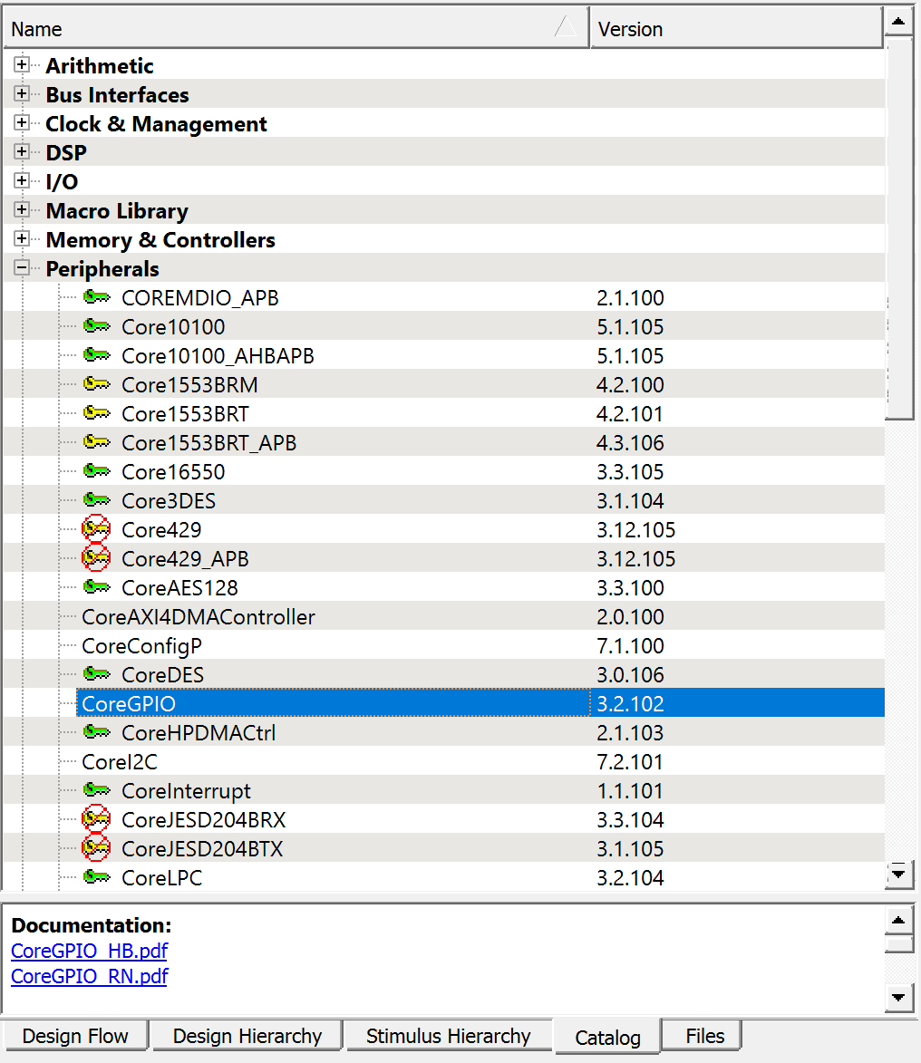
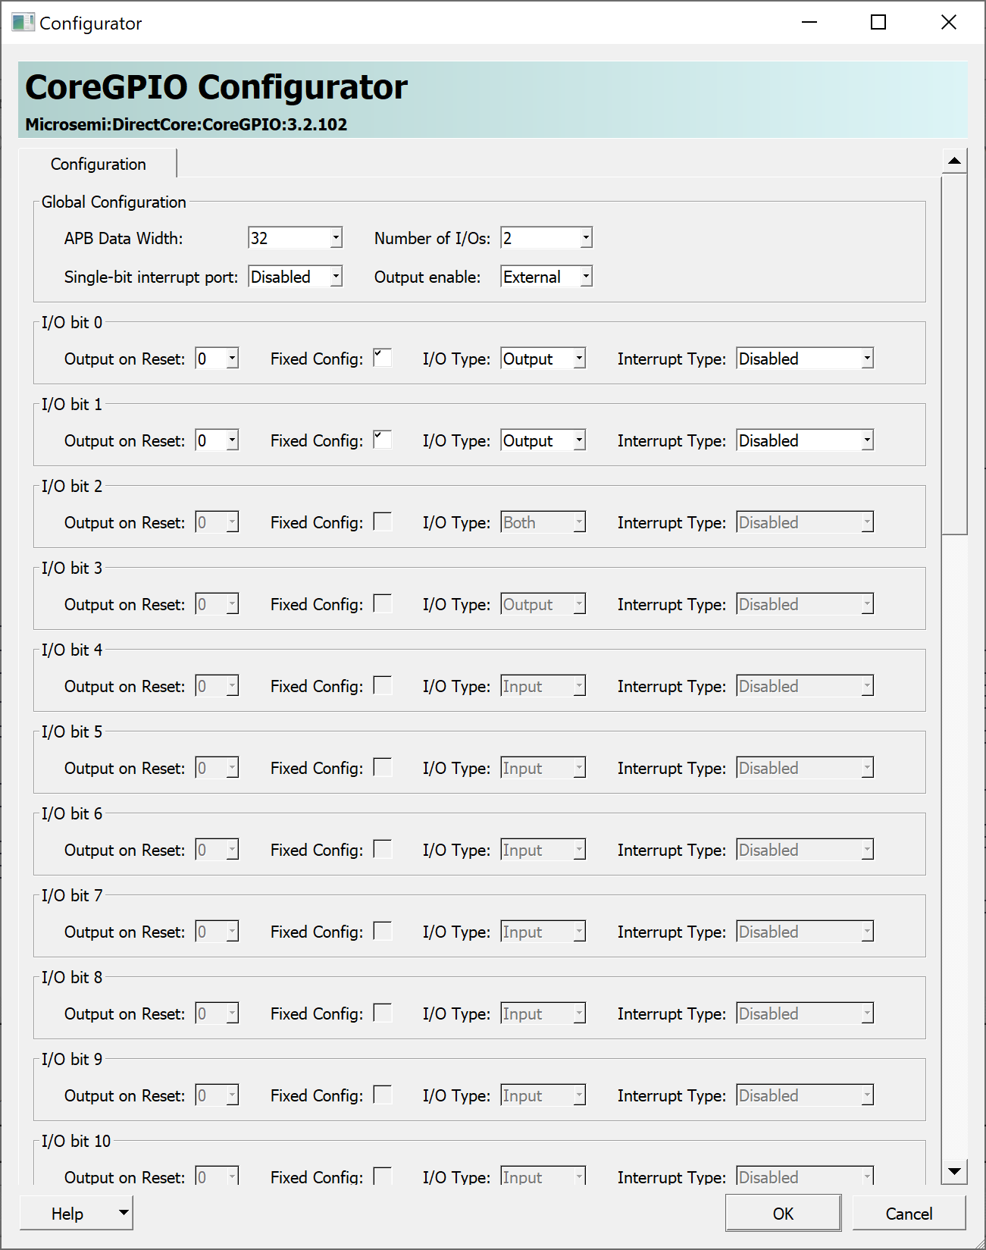
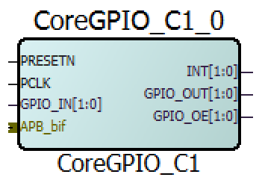
Step 2: Add and Configure CoreGPIO
To add a GPIO core, go to Catalog > Peripherals > CoreGPIO
Give it a name or leave as default
In CoreGPIO Configurator, change Number of I/Os to 2
Check the boxes Fixed Config for I/O bit 0 and bit 1
Set them as Output and click OK
7
8
9
5
Fig. 4. CoreGPIO in Catalog
Fig. 6. Unconnected CoreGPIO in SmartDesign
Fig. 5. CoreGPIO configured with two outputs

Slide 5
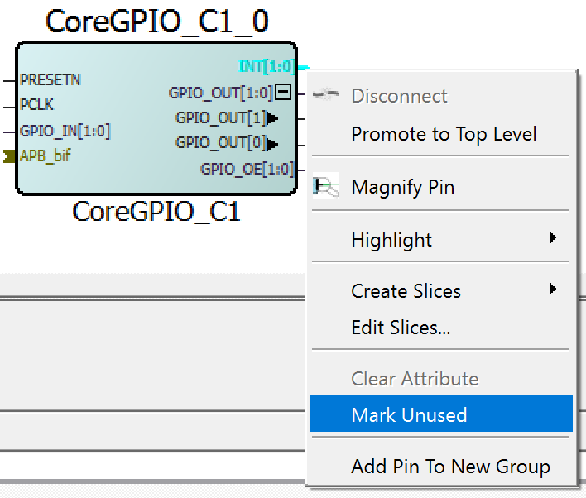
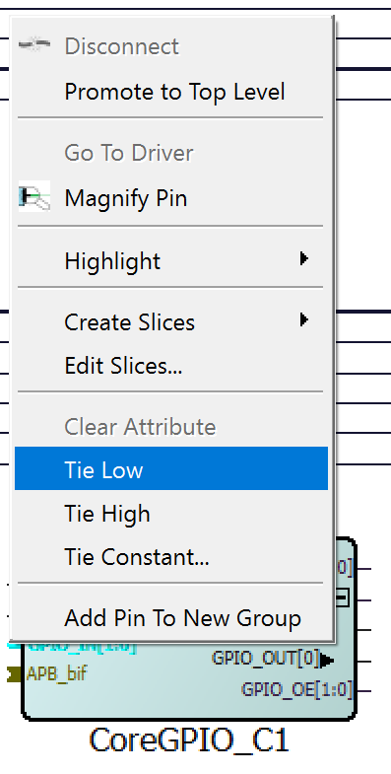
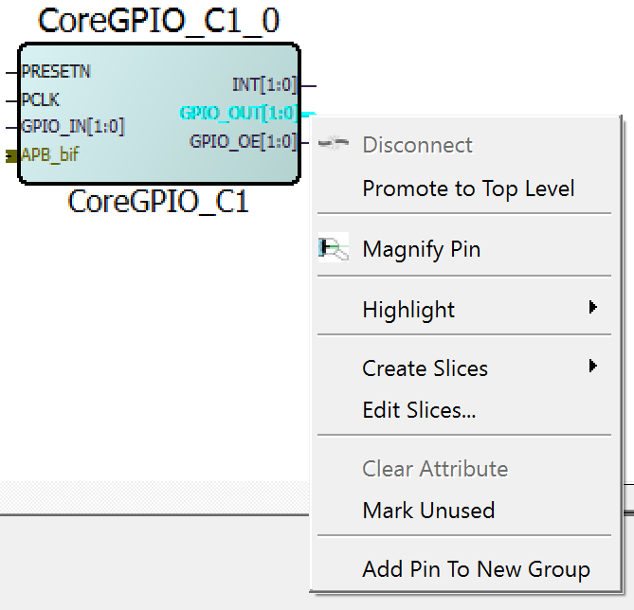
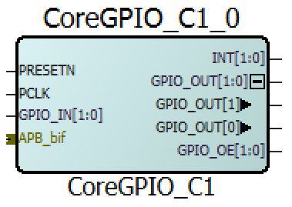
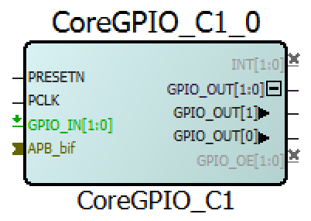
Step 3: Configure CoreGPIO Pins
In the SmartDesign, right-click on the pin of GPIO_OUT
Choose Create Slices
Right-click GPIO_IN pin
Choose Tie Low
Right-Click INT and choose Mark Unused
Repeat step 14 to GPIO_OE
Fig. 9. Set INT and GPIO_OE as unused
Fig. 7. Edit GPIO_OUT to reveal individual pins for outputs
Fig. 10. Completed configuration for CoreGPIO
Fig. 8. Tying input pin to low

Slide 6
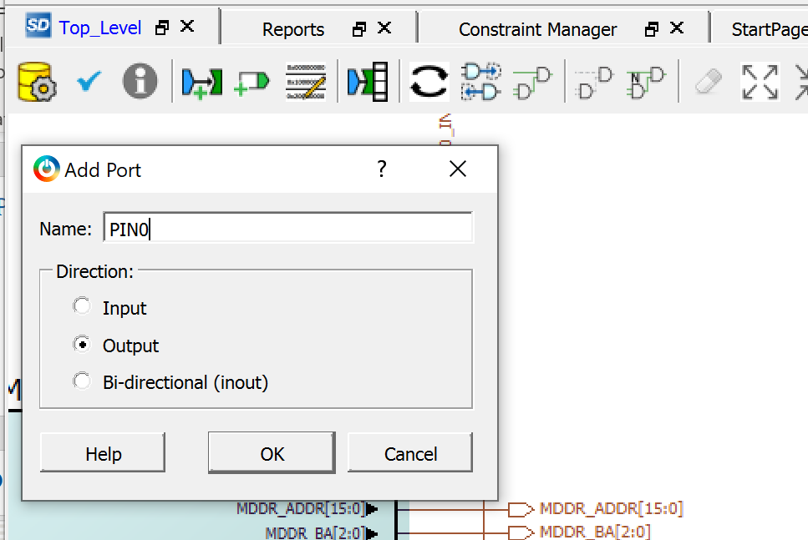
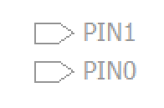
Step 3: Add 2 Output Ports
Click on Add Port button
Name the port
Set Direction as Output
Click OK
Repeat these steps to add another output port
18
19
20
21
Fig. 14. Two output ports, labeled PIN1 and PIN0
They are located on the top right corner of the design and can be moved.
Fig. 13. Adding a new output pin

Slide 7
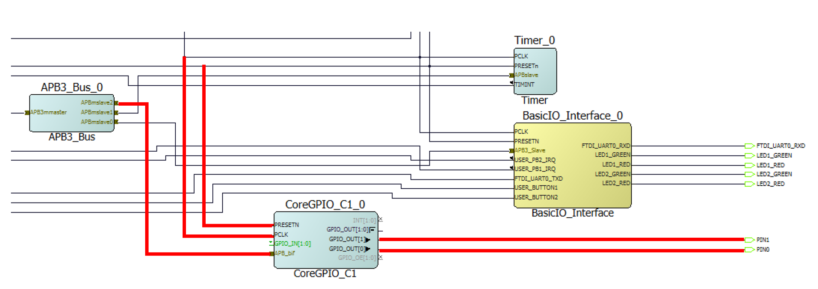
Step 4: Make Connections
Make the connections as shown using Connection Mode button (drag and drop to make connections)
Fig. 16. Connection mode button on toolbar
Fig. 15. New connections highlighted in red that connects APB3_BUS_0 to CoreGPIO and output ports

Slide 8
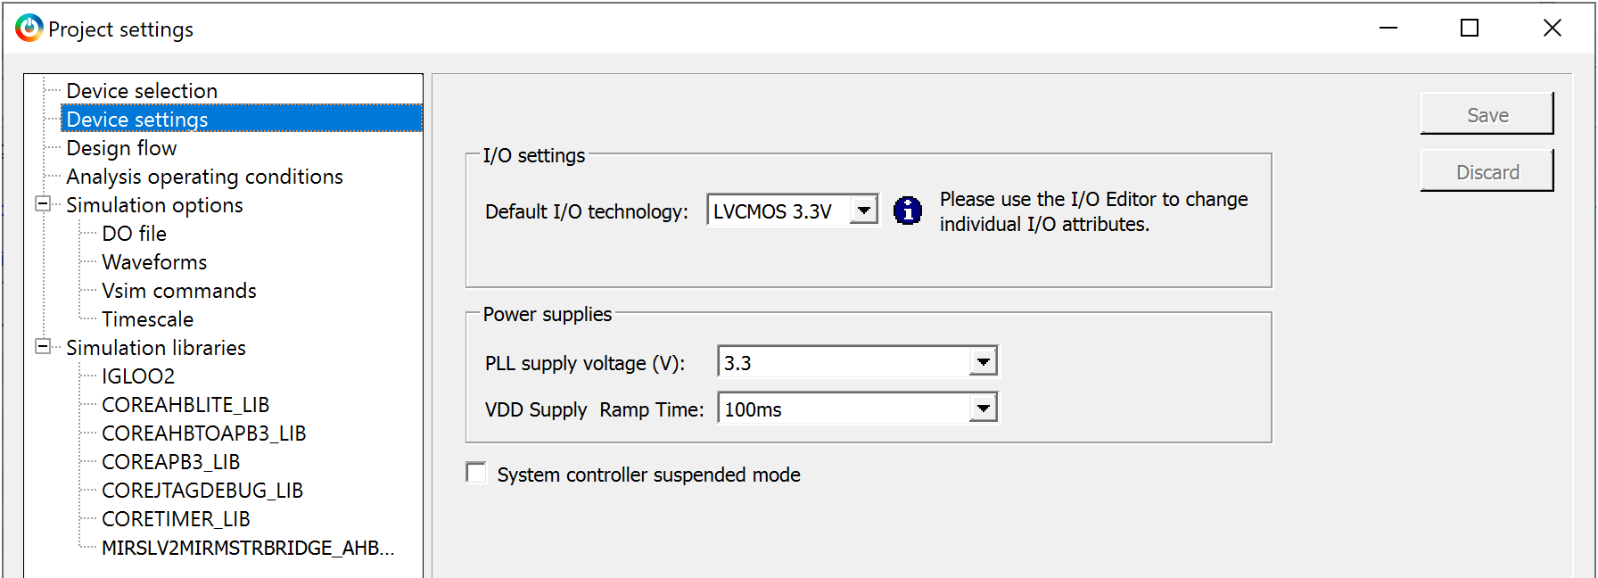
Project Settings (Optional)
Fig. 17. I/O settings in Project settings
To change the I/O settings to 3.3V, go to Project > Project Settings
In Device Settings, change Default I/O technology to LVCMOS 3.3V
Click on Save and close it

Slide 9
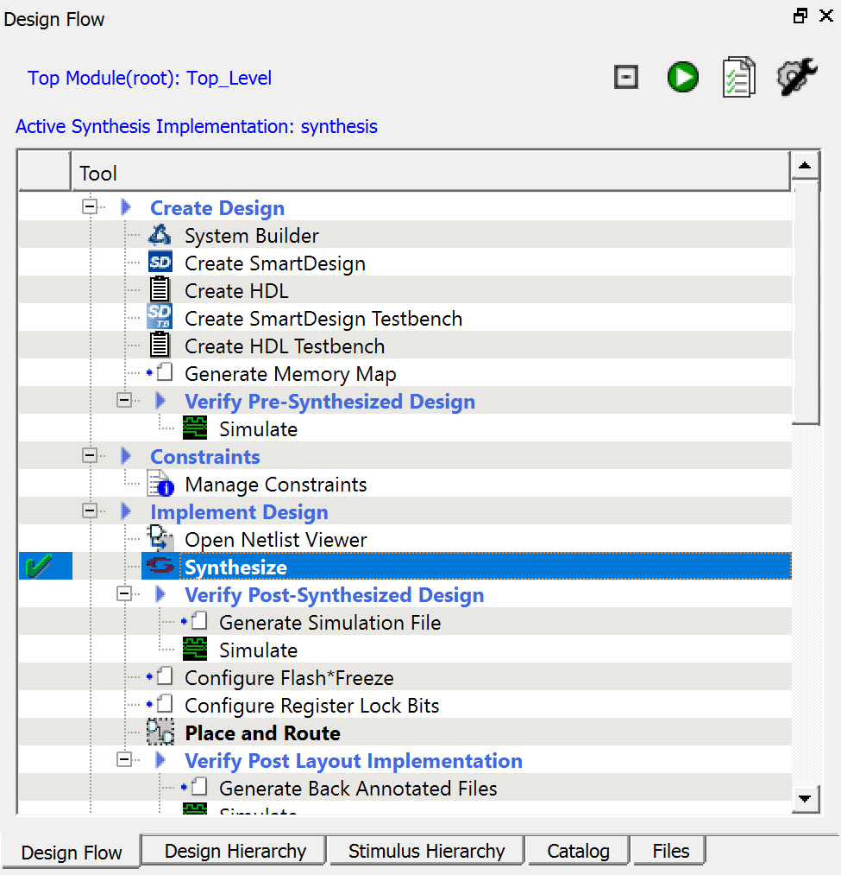
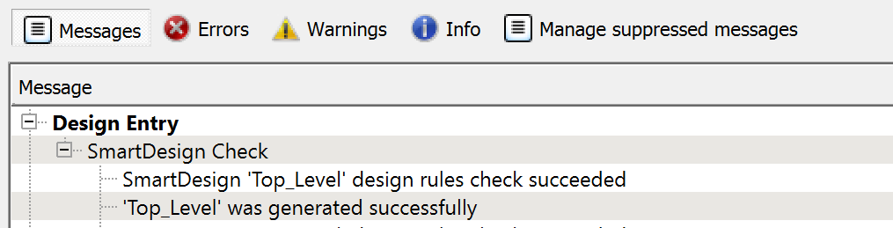
Step 5: Verify and Synthesize
28
27
Fig. 18. Design Rules Check and Generate Component buttons
Fig. 19. Error free design after Design Rules Check and Generate Component
In the SmartDesign, click on Design Rules Check
Then click on Generate Component
Next, in Design Flow double-click Synthesize
A green check mark will appear if there are no errors
Fig. 20. Synthesize in Design Flow

Slide 10
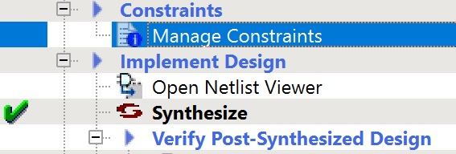
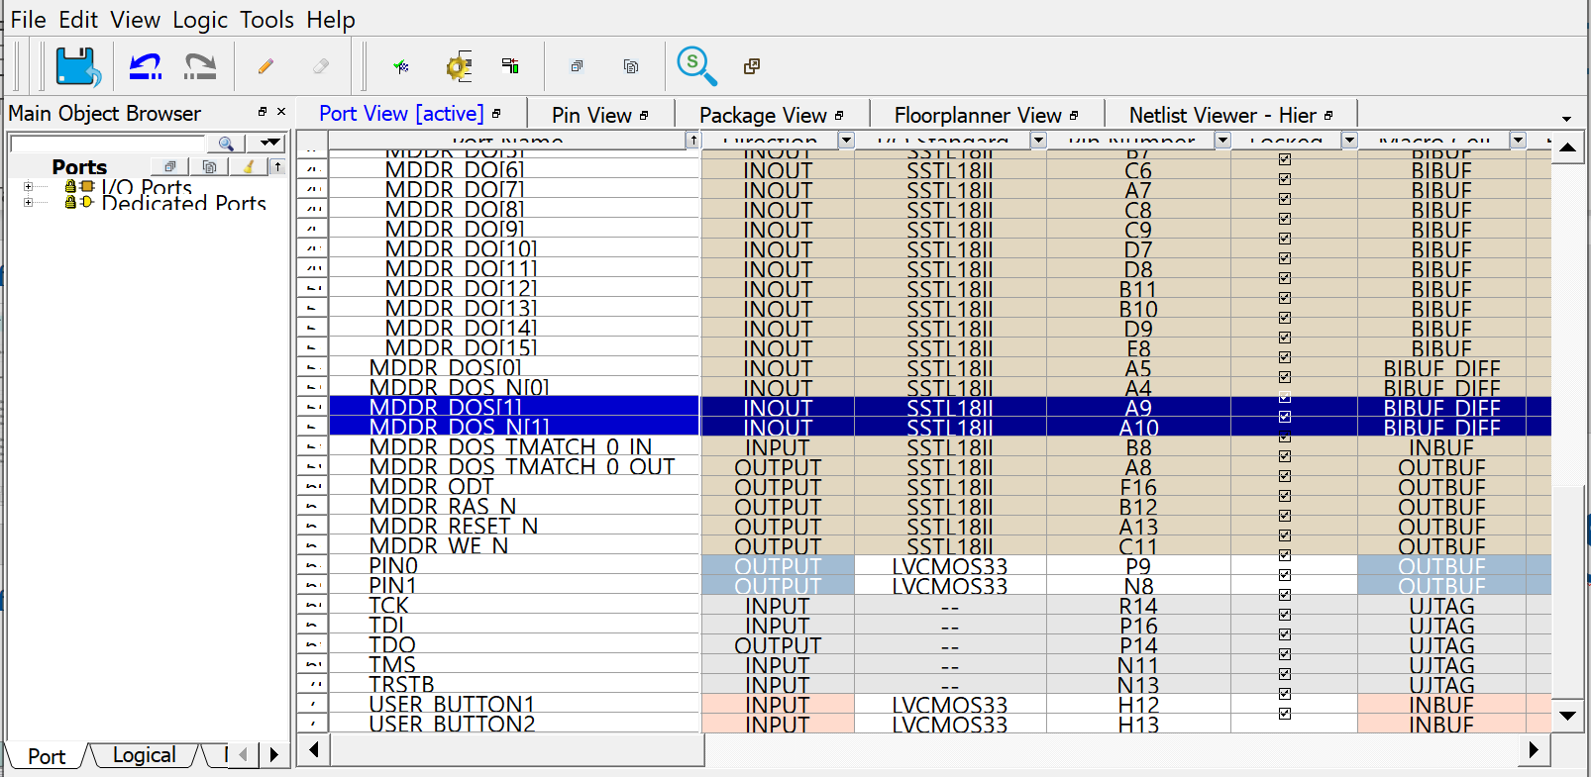
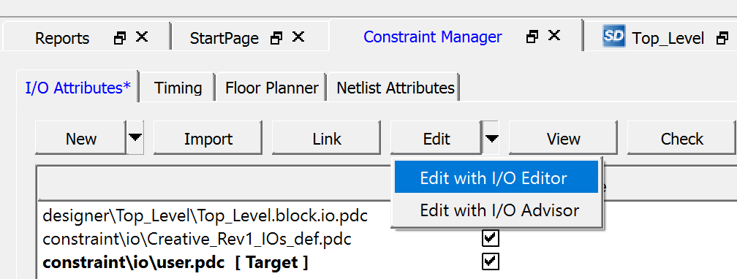
Step 6: Pin Assignments
33
30
Fig. 21. Manage Constraints in Design Flow
31
32
32
Fig. 22. Opening I/O Editor in Constraint Manager
Fig. 23. List of ports in the design, including the two new output ports created
Double-click on Manage Constraints in Design Flow
Click on Edit on Constraint Manager
Choose Edit with I/O Editor
In I/O Editor, look for the two new ports created earlier
Assign the pins
Click on Commit and close the window
Table 1. Output ports with corresponding FPGA pin number and pin name
Port | FPGA Pin | Pin Name
PIN0 | P9 | D7
PIN1 | N8 | D6

Slide 11
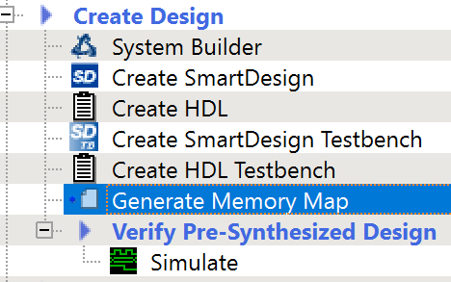
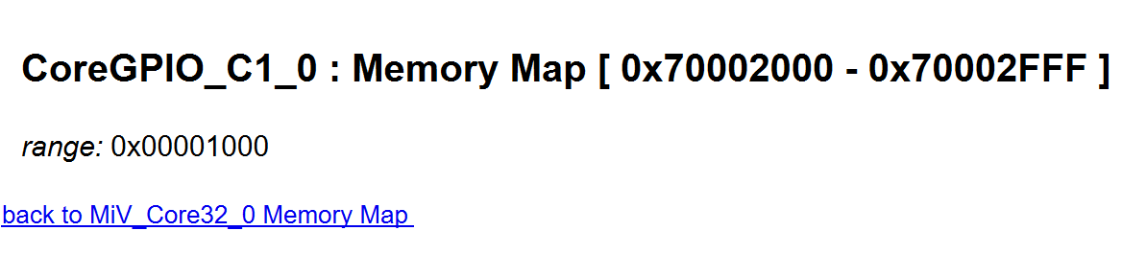
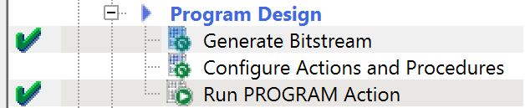
Step 7: Generate and Run the Design
Click on Generate Memory Map in Design Flow
Address of the CoreGPIO will be at the bottom of the generated datasheet
Double click Generate Bitstream
Green check mark should appear
Connect to FPGA board
Double click Run PROGRAM Action
If the program is running on SoftConsole, terminate it before clicking on Run PROGRAM Action
Fig. 24. Generate Memory Map in Design Flow
Fig. 25. CoreGPIO memory address from the report generated
38
40
Fig. 26. Generate Bistream and Run PROGRAM Action in Design Flow

Slide 12
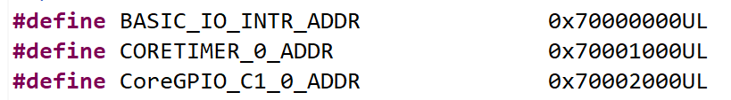
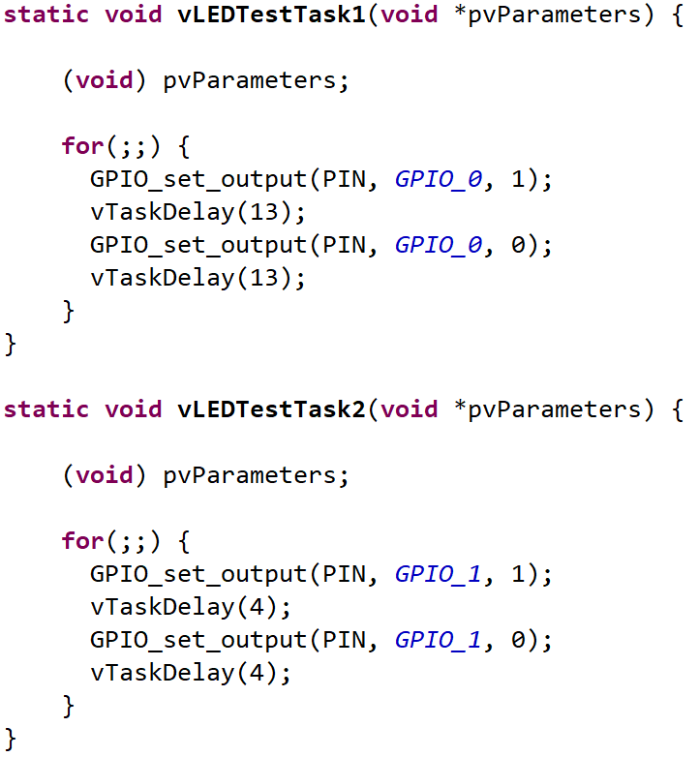
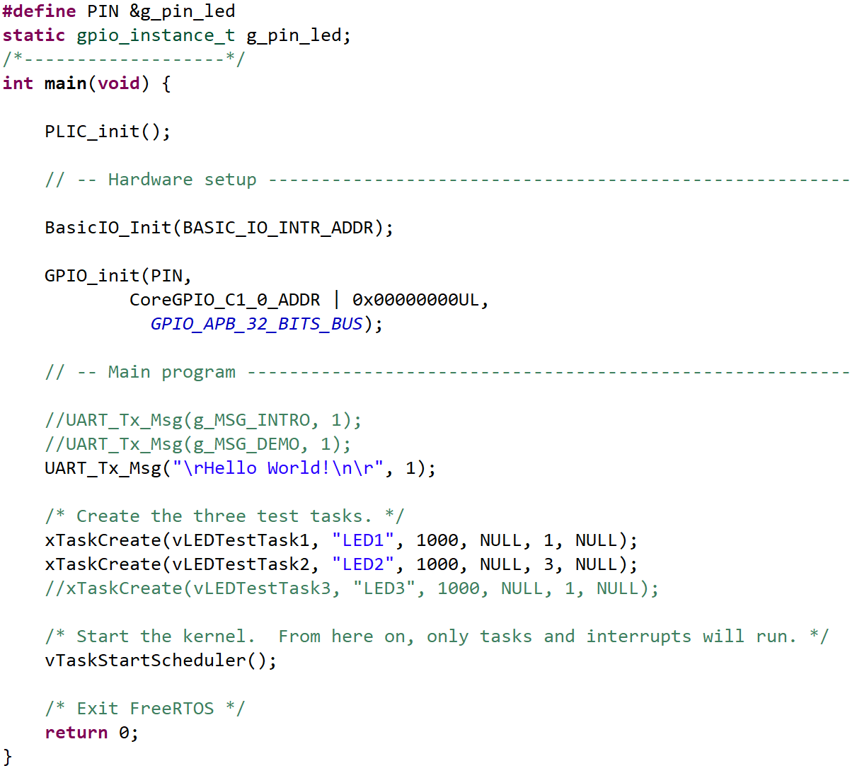
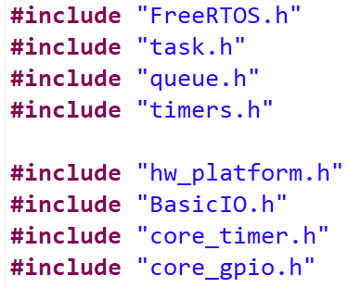
Step 8: Modify the Code on SoftConsole
Modify/Add the code in the red boxes in main

Slide 13
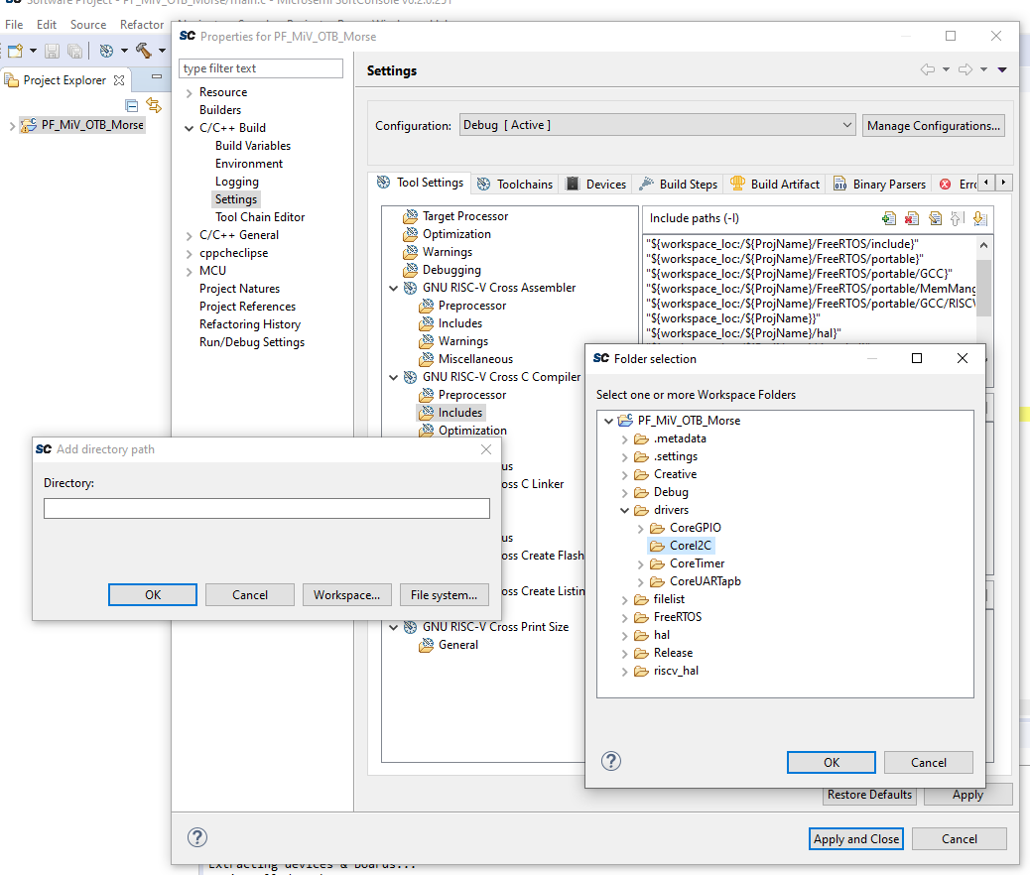
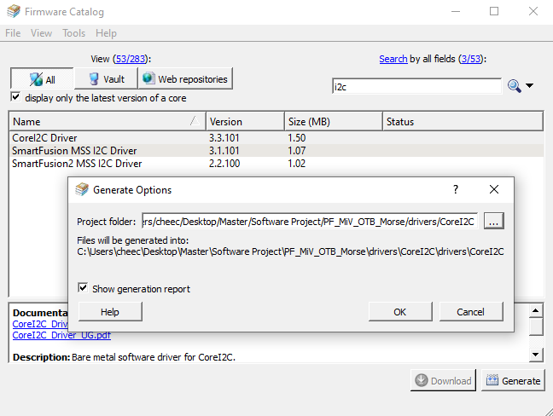
Step 9: Add Drivers (not needed for now)
Open Firmware Catalog
Search for necessary drivers used in your hardware design
Click Generate
Choose where to save files and click OK
Fig. ??. Importing driver files into software project on SoftConsole SDK
Fig. ??. Downloading drivers from Firmware Catalog
On SoftConsole, right-click project and click on Properties

Slide 14
Understanding xTaskCreate
PARAMETERS
xTaskCreate( TaskFunction_t pvTaskCode, // Task functions. Normally implemented as infinite loop.
const char *pcName, // Descriptive name for task (Max length = 16).
configSTACK_DEPTH_TYPE usStackDepth, // Stack size (memory) allocated for task. Specified as no. of words (not byte).
void *pvParameters, // Pointer for any parameter that needs to be passed to the task.
UBaseType_t uxPriority, // Priority of the task.
TaskHandle_t *pxCreatedTask // Address of the task handle
);
EXAMPLE
//Creates task with vLEDTestTask1 function
xTaskCreate(vLEDTestTask1, "LED1", 1000, NULL, 1, NULL); // with name “LED1”, stack size of 1000 word,
// no parameter passed, priority of 1, and no handle;
…
…

Slide 15
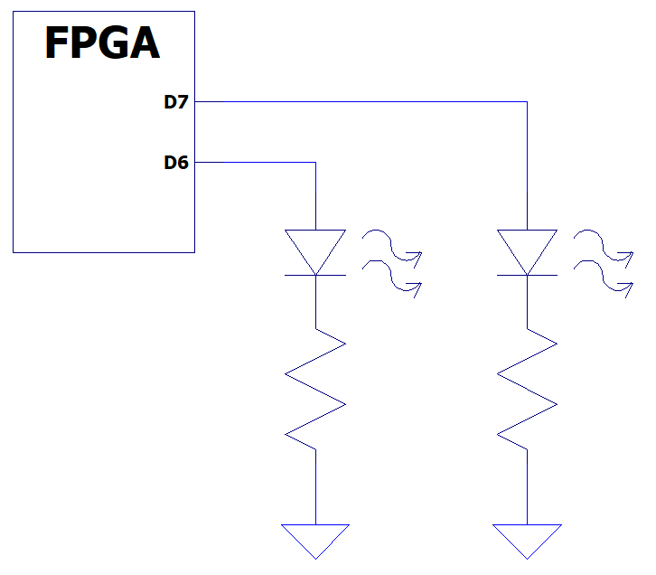
Step 10: Build and Debug the Project
4
5
Fig. 29. SoftConsole tool bar
3
Connect the testing circuit to the FPGA specified pins
To go back to C/C++ perspective, click on C/C++ button on top right corner
Select the project in Project Explorer and click on Build button
If there are no errors, click on Debug button
Switch to debug perspective and Resume the program
The LEDs connect to the FPGA should blink and “Hello World!” is printed onto the terminal.
500Ω
500Ω
Fig. 28. Circuit to test the two GPIO added to demo project

